Slide 1
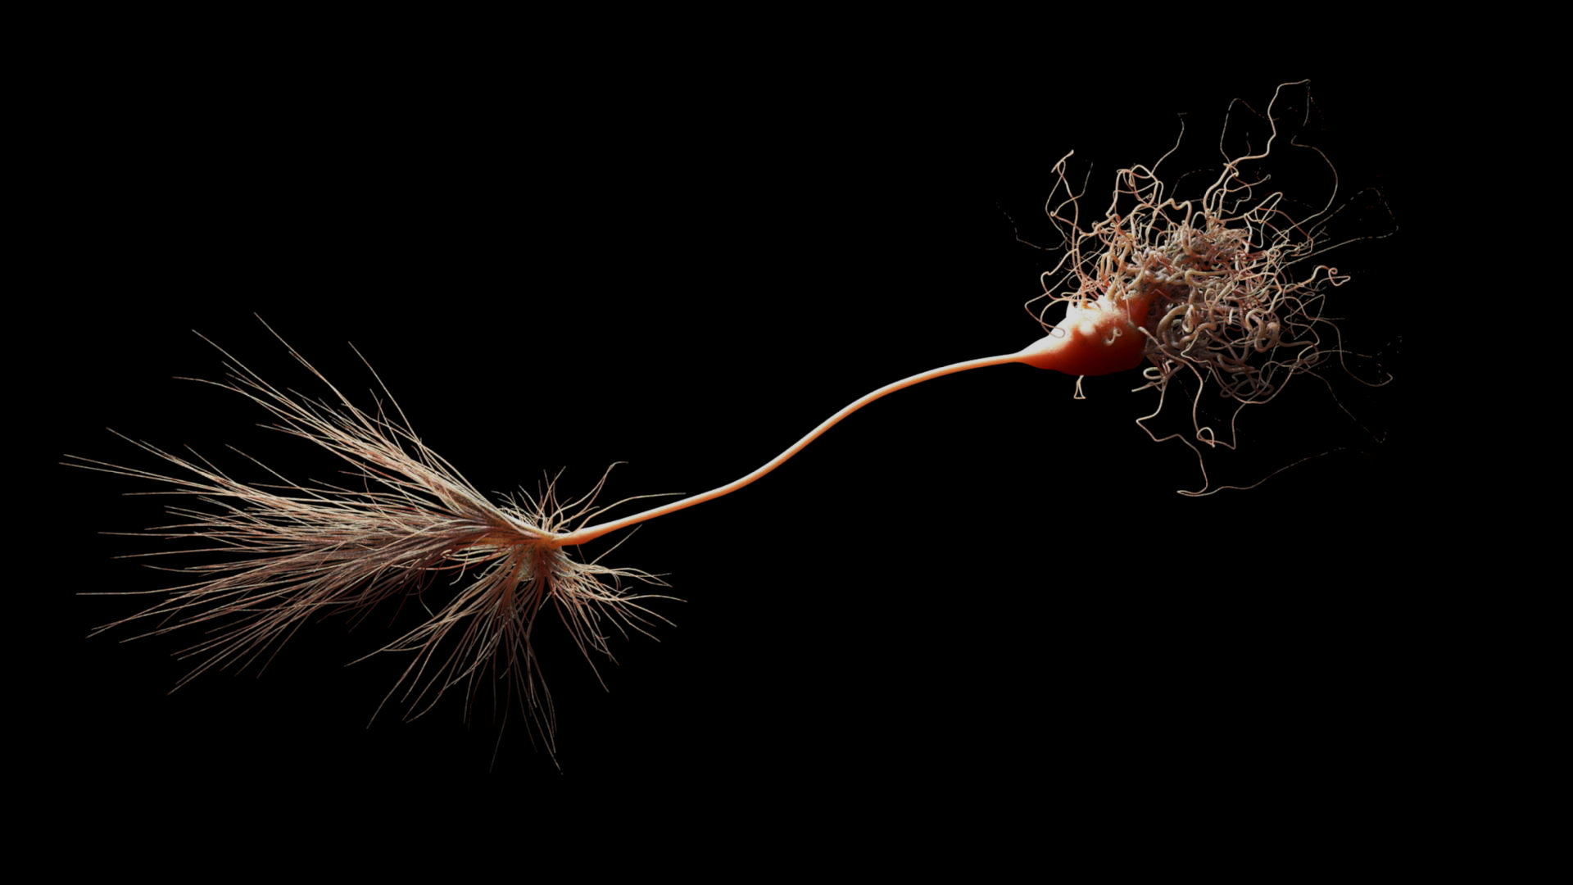
October 18, 2019
Replica-Mean-Field Limit of
Spiking Neural Networks
Luyan Yu ( 俞陆炎 )
Department of Physics,
University of Texas at Austin
Supervisor: Dr. Thibaud Taillefumier
Department of Mathematics & Department of Neuroscience,
The University of Texas at Austin
Notes:
Good afternoon everyone! Today I’ll be doing my qualifier here. Thank you Professor Demkov, Morrison, Hazeltine, Marder for being part of my qualifier committee.
My name is Luyan Yu. My supervisor is Dr. T from the department of mathematics and neuroscience, who is also here today.
The topic of my presentation is, as you see, replica mean field limit of spiking neural networks.
Let’s get started.

Slide 2
Introduction
Notes:
Before I dive into details, I will give a brief introduction so that you will get the background of our research.
Here is a brain. I’m pretty sure everyone in this room has one.
Here are some facts about the brain.

Slide 3
Introduction
A regular human brain contains:
~100 billion neurons
~100 trillion synapses
Notes:
In a regular adult human brain, there are around 100 billion neurons and among these neurons, we have about 100 trillion synapses connecting them.

Slide 4
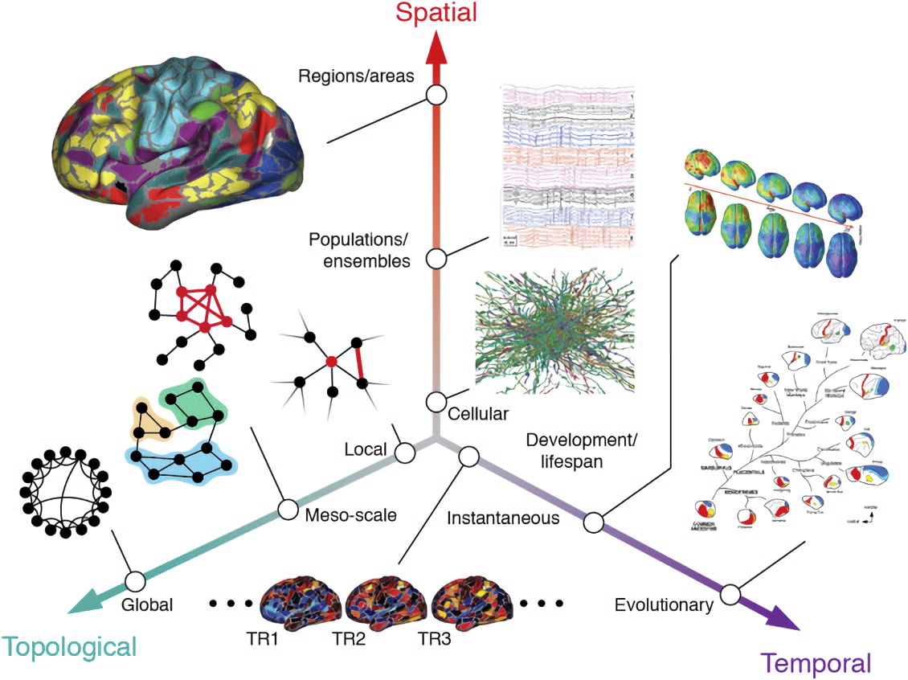
Introduction
A complex system operates on multiple scales
( Betzel, R. F., & Bassett, D. S. (2017). Neuroimage, 160, 73-83. )
Notes:
All these neurons and synapses together form an extremely complicated biological system that operates on multiple scales.
For example, in the finest spatial granularity, we are looking at hundreds of different chemical reactions happening everywhere in the brain. Or on a macroscopic level, the brain is subdivided into different regions that are responsible for different tasks.
And also, if we look at temporal scales, the transmission of neural signals is around 10ms, while the long-term memory kept in our brain can last for years or even lifetime.
There are also multiple topological scales of the network present in the brain.
You may now have a taste of how complex the brain is.

Slide 5
Introduction
( Movie from: Man vs. Wild )
Notes:
And it is such a brain that helps us find the food, create tools, make a fire, and survive in this cruel environment.

Slide 6
Introduction
How does the neurons perform all these computations?
( Movie from: Man vs. Wild )
Notes:
But the bad news is, we don’t know how on earth this is done.
There are a lot of questions.
How does the neural network encode the information from our sensory inputs?
How does the neural network perform computations?
What kind of language do they use?
It seems hopeless to deal with 100 billion neurons at this stage. Why don’t we just look at a single neuron?

Slide 7
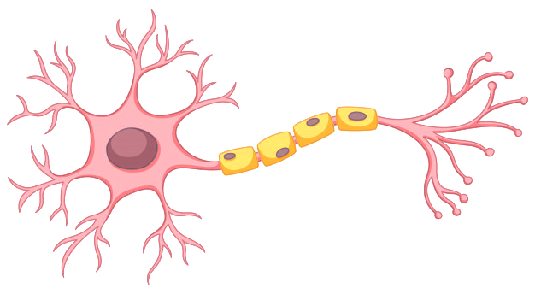
Introduction
Neuron
Dendrite
Synapse
Axon
Soma
Notes:
This is a schematic figure of a neuron.
The details of the neurons may vary across individuals. But the basic building blocks of a neuron are the following four parts:
The dendrites, which receive signals from other neurons and propagate them to the soma;
Which is the cell body of the neuron, who collects the signals from dendrites and fires electrical signal at appropriate time;
Then the signal is transmitted along this axon
When the signal arrives at the end of the axon, it triggers the release of neurotransmitter to the synapse, which goes to the succeeding neurons.
(Meylin Sheath and Schwann cell)

Slide 8
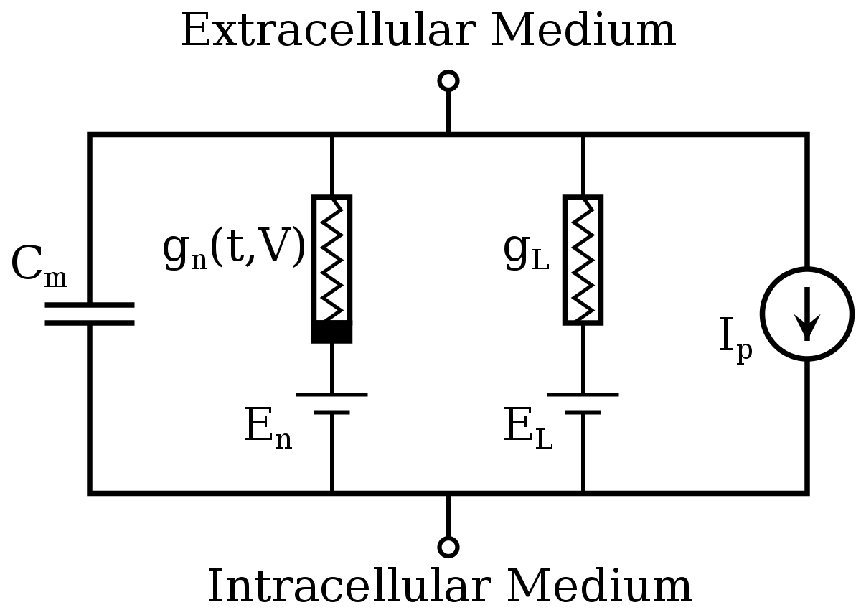
Introduction
Hodgkin-Huxley Model
1963 Nobel Prize in Physiology or Medicine
Set of coupled nonlinear ODEs
( Hodgkin, A. L., & Huxley, A. F. (1952). The Journal of physiology, 117(4), 500-544. )
Notes:
For a single neuron, it is not hopeless to describe its behavior. For example, we have this Nobel Prize Winning model proposed by Hodgkin and Huxley.
It sees a neuron as a circuit shown on the right. This model describes the neuron firing activities from its underlying ionic mechanisms. In the end, we will have a set of nonlinear ordinary differential equations to solve.
Once we’ve chosen the parameters appropriately, it can describe a single neuron quite accurately.

Slide 9
Introduction
But for a network of neurons…
only simulation is possible!
Notes:
But the problem is if we have a network of neurons, what we can do with those model is very limited.
In most cases, we can only perform simulations.
Simulation is a good tool. It can, for example, [click] create beautiful visualization.

Slide 10
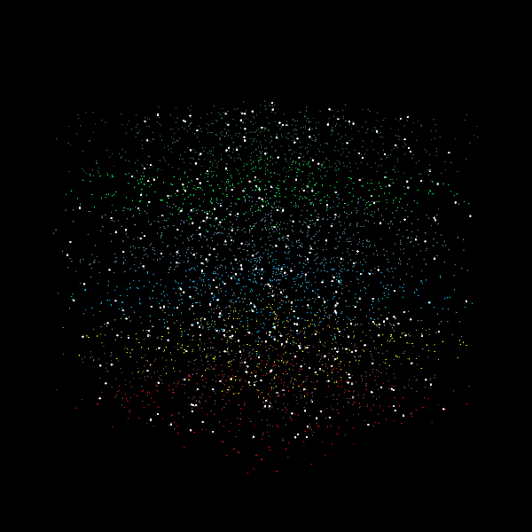
Introduction
8 / 35
Notes:
or get some statistics of a neural network with a certain choice of parameters. But that’s basically it. Without the guidance of theory, simulations are more like trial and error. And we certainly want more than that. So we need to do simplifications.

Slide 11
Introduction
Integrate-and-Fire Model
$$C_{m}\frac{ⅆV}{ⅆt}=I_{p}(t)$$
Fires when reaches threshold $V_{th}$
( Abbott, Larry F. Brain research bulletin 50.5-6 (1999): 303-304. )
Notes:
This integrate and fire model is one possible simplification.
It treats a neuron as just a capacitor who fires whenever it reaches a threshold voltage.

Slide 12
Introduction
Integrate-and-Fire Model
$$C_{m}\frac{ⅆV}{ⅆt}=I_{p}(t)$$
Japanese Bamboo Fountain
Fires when reach threshold $V_{th}$
( Abbott, Larry F. Brain research bulletin 50.5-6 (1999): 303-304. )
Notes:
This movie of the Japanese bamboo fountain is a very illustrative analog of the integrate and fire model.

Slide 13
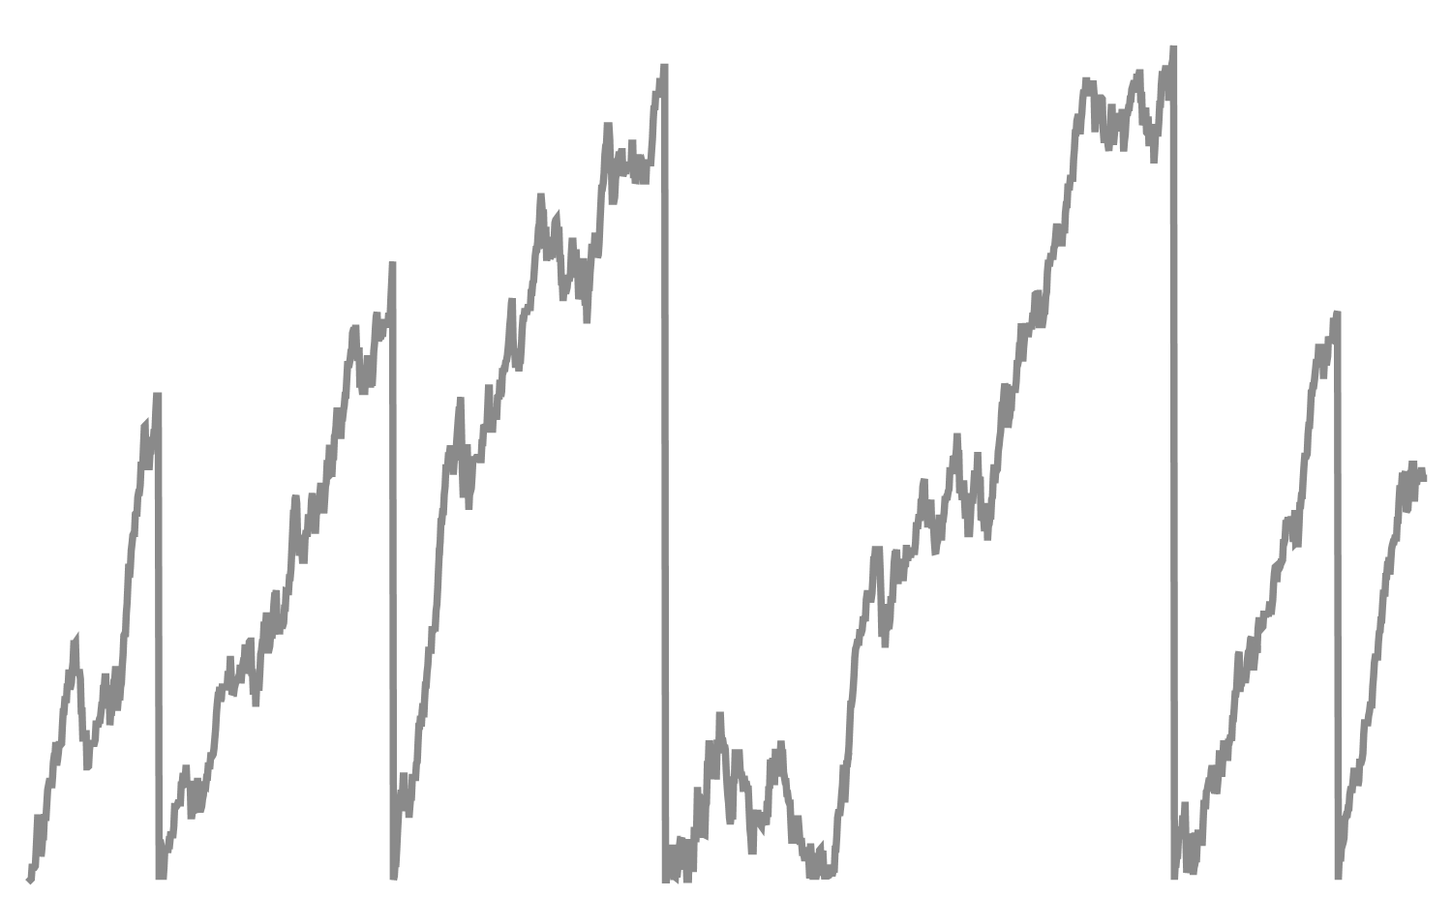
Introduction
Stochastic Intensity and Point Process
$$t$$
$$t$$
Still difficult inside a network…
Notes:
But today we are gonna simplify it even more. We’ll describe a neuron by stochastic intensity and point process. I’ll explain them at length in the later slides.
Now what we need to know is that it is still difficult even with such simplifications. And the difficulty lies in the presence of interaction among neurons when they live in a network.
We’ve already learnt such lessons in physics when dealing with many-body systems. The presence of interaction is always a pain.
Further simplification about the network should be done.

Slide 14
Introduction
Thermodynamic-mean-field limit
Number of neurons $K→∞$, strength of synapses $μ→0$
Mean-field limit of generalized Hawkes processes.
Chevallier, J. (2017). Stochastic Processes and their Applications, 127(12), 3870-3912.
Mean-field description and propagation of chaos in networks of Hodgkin-Huxley and FitzHugh-Nagumo neurons.
Baladron, J., Fasoli, D., Faugeras, O., & Touboul, J. (2012). The Journal of Mathematical Neuroscience, 2(1), 10.
A constructive mean-field analysis of multi population neural networks with random synaptic weights and stochastic inputs.
Faugeras, O. D., Touboul, J. D., & Cessac, B. (2009). Frontiers in computational neuroscience, 3, 1.
Mean-field analysis of neuronal spike dynamics.
Treves, A. (1993). Network: Computation in Neural Systems, 4(3), 259-284.
Critical dynamics and fluctuations for a mean-field model of cooperative behavior.
Dawson, D. A. (1983). Journal of Statistical Physics, 31(1), 29-85.
Notes:
A commonly adopted simplification is the thermodynamic mean field limit. In this limit, we take the number of the neurons tend infinity and the strength of the synapses among neurons to zero.
[click]
Most of the analytical analysis is done in this thermodynamic limit.

Slide 15
Introduction
Thermodynamic-mean-field limit
Number of neurons $K→∞$, strength of synapses $μ→0$
Problems
Resolutions
Finite-size effect
Correction terms
Correlation
Diagrammatic expansion
$\lim_{K→∞}$ $\lim_{t→∞}≠\lim_{t→∞} \lim_{K→∞}$
Notes:
But this limit has its intrinsic shortcomings. First, at the time we take the number of neurons to infinity, we lose the finite-size effect of the network. Also, since the synaptic strength goes to zero, the correlation between neurons vanishes.
There are also subtle problems such as these two limits do not commute. Here K is the number of neurons as usual and t is the time. When we are interested in the stationary state, we take the time to infinity. If they don’t commute, the infinity size limit of the stationary state may not be the stationary state of the infinity network. The results we obtain from this limit will not be physical.
[click]
There are a few physics-inspired ways to remediate these problems. For example, by adding correction terms to the master equations. And there exists diagrammatic expansion that’s inspired by Feynman diagram.

Slide 16
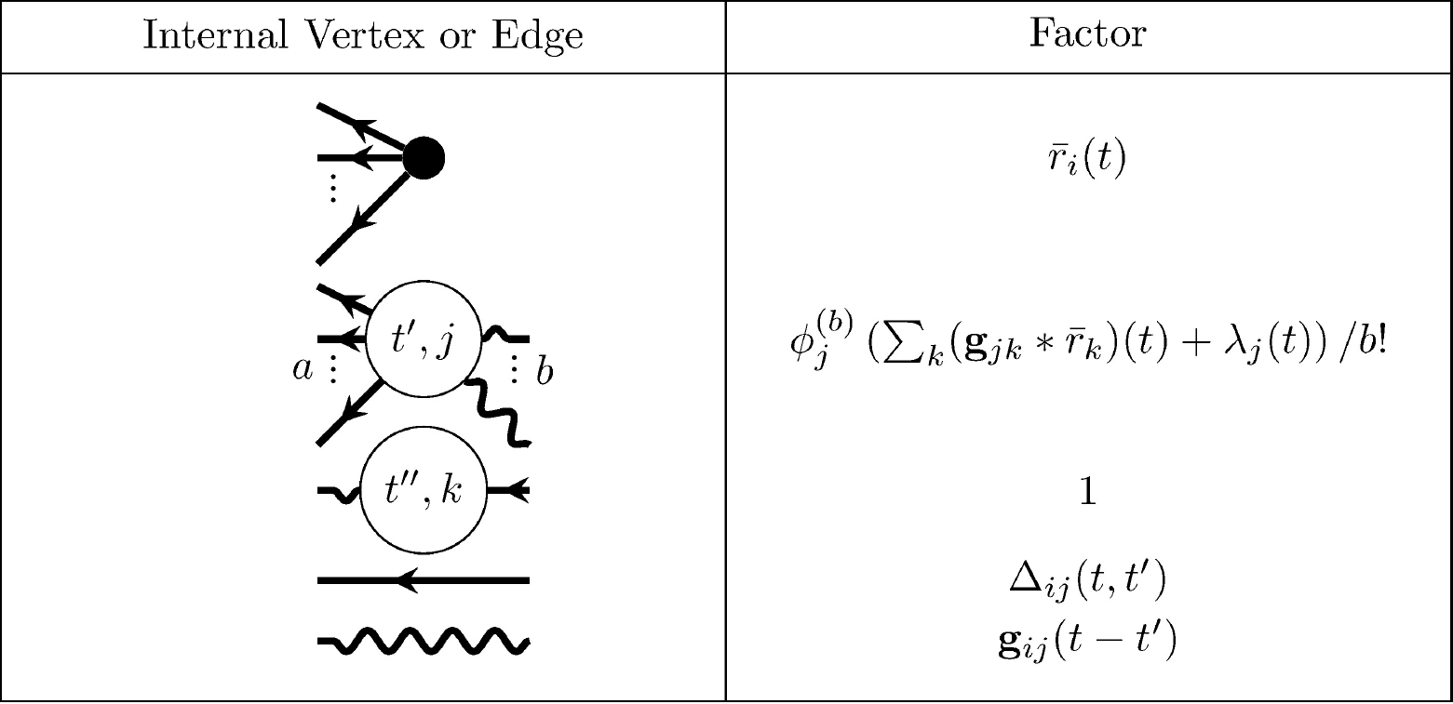
Introduction
Linking structure and activity in nonlinear spiking networks.
Ocker, G. K., Josic, K., Shea-Brown, E., & Buice, M. A. (2017). PLoS computational biology, 13(6), e1005583.
Feynman-like diagrammatic expansion
Notes:
For example, this paper proposed a set of Feynman rules to compute the series expansions of the quantities in a network.
But as in physics, these kind of methods suffer from its convergence problems. And so is this one. The convergence of this method is still unclear.

Slide 17
Introduction
Replica-mean-field limits for intensity-based neural networks.
Baccelli, F., & Taillefumier, T. (2019). arXiv preprint arXiv:1902.03504.
Thermodynamic-mean-field limit
Replica
Notes:
What we are gonna do today is to introduce you to a new kind of limit – the replica mean field limit.

Slide 18
Outline
1
Toy Model: Linear Counting Neurons
2
We Need Inhibition: Rectified Linear Counting Neurons
3
New Math: Exponential Firing Neurons
Notes:
This is the outline of my talk in the next 40min.
First I will introduce you all the concepts that are due to be explained through this toy model.
But this toy model suffers from the fact that it can not include inhibition. So we introduce the rectified linear counting neurons that can solve part of the problem.
Then we will briefly talk about the ongoing research of this exponential firing neurons model that involves new math and can potentially solve the inhibition problem better.

Slide 19
Stochastic Intensity Formulation
Neuron
$$i$$
Point process
receive other neurons’ spikes
reset when spike
Intensity
$$λ_{i}(t)$$
$$t$$
Point process
$$t$$
$$N_{i}$$
Notes:
Through out our work, we will model the neuron using the stochastic intensity formulation.
In this formulation, we treat a neuron as an abstract object whose spiking events are modeled as point process.
The simplest point process is the Poisson process, which can be described by one constant, the rate, or called the intensity.
[click]
Here for our neuron, we use a time dependent stochastic intensity, or in this case we can call it the instantaneous firing rate of the neuron. Biologically speaking, this will correspond to the membrane voltage.
This is a typical trace of the stochastic intensity. When we put the neuron inside a network, there are two factors affecting the intensity of the neuron.
[click]
Here this kind of trace is due to the neuron receiving spikes from other neurons.
[click]
While this is when the neuron itself spikes and reset its intensity to a give base rate.
[click]
And the point process of this neuron is all these points in time that marks the spiking event of this neuron. This point process is what other neurons can feel.

Slide 20
Stochastic Intensity Formulation
Neuron
$$i$$
Point process
receive other neurons’ spikes
reset when spike
Can we solve the time-dependent probability distribution for a network?
Intensity
stationary state
firing rates
$$λ_{i}(t)$$
$$t$$
Point process
$$t$$
$$N_{i}$$
Notes:
Now a natural question arises. Can we solve the time-dependent probability distribution for a network of neurons?
This looks like a difficult question. Let’s simplify it.
[click]
First, it’s always easier to consider the stationary state.
[click]
And, instead of the full probability distribution, we just want the firing rates, which is the first moments.
To answer this question, we need to be more specific on our model.

Slide 21
Linear Counting Neurons
$K$ fully connected excitatory neurons, homogeneous synaptic strength $μ$
Stochastic intensity
$$1$$
$$λ_{i}\left(t\right)=b+μC_{i}\left(t\right)$$
$$μ$$
$$μ$$
$$3$$
Counting variable $C_{i}\left(t\right)$
remembers how many spikes a neuron receives since its last spike
$$μ$$
$$2$$
Notes:
Let’s consider this toy model.
Suppose we have a network with K fully connected excitatory neurons with homogeneous connection strength \mu.
We assume the intensity has a linear relationship with the counting variable C.
The so called counting variable is a internal variable that remembers how manys spikes a neuron receives since its last spikes.

Slide 22
Linear Counting Neurons
$K$ fully connected excitatory neurons, homogeneous synaptic strength $μ$
Stochastic intensity
$$1$$
$$λ_{i}\left(t\right)=b+μC_{i}\left(t\right)$$
$$μ$$
$$μ$$
$$3$$
Counting variable $C_{i}\left(t\right)$
$$μ$$
receive a spike
spike and reset
$$2$$
$$C_{i}\left(t\right)→C_{i}\left(t\right)+1$$
$$C_{i}\left(t\right)→0$$
Notes:
Specifically, when a neuron receives a spike, the counting variable increases by one, which results in the increase of intensity by \mu.
When the neuron itself spikes, the counting variable reset to zero, which corresponds to setting the intensity to the base rate b.

Slide 23
Linear Counting Neurons
$$N_{3}$$
$$N_{2}$$
$$N_{1}$$
$$t$$
$$1$$
$$C_{3}\left(t\right)$$
$$μ$$
$$3$$
$$2$$
$$1$$
$$t$$
$$μ$$
$$3$$
$$C_{2}\left(t\right)$$
$$μ$$
$$3$$
$$2$$
$$2$$
$$1$$
$$t$$
$$C_{1}\left(t\right)$$
$$3$$
$$2$$
$$1$$
$$t$$
Notes:
This is an example of the trajectory of the counting variables in this three-neuron network.
The top figure represents the spiking events of the three neurons.
As we can see the first spiking is generated by neuron no.2. Let’s see how the counting variables change. Since neuron no.1 and 3 are connected to neuron no. 2. Their counting variables are increased by one respectively. While the counting variable of neuron no.2 remains zero due to reset.
Then the next spike is by neuron no. 3. As a result, C1 and C2 increase by one and C3 is reset to zero.
Let’s look at another event by neuron no. 2, you’ve already got the pattern right? C1 and C3 increase by one and C2 becomes zero.
And so on so forth.

Slide 24
Linear Counting Neurons
$$N_{3}$$
$$N_{2}$$
$$N_{1}$$
$$t$$
$$1$$
$$C_{3}\left(t\right)$$
$$μ$$
$$3$$
$$2$$
Can we solve the stationary state firing rate for a network?
$$1$$
$$t$$
$$μ$$
$$3$$
…NO!
$$C_{2}\left(t\right)$$
$$μ$$
$$3$$
$$2$$
$$2$$
$$1$$
$$t$$
$$C_{1}\left(t\right)$$
$$3$$
$$2$$
$$1$$
$$t$$
Notes:
Now let’s go back to our question. Can we solve the stationary state firing rate for a network?
The answer is, as I already mentioned in the introduction, no
Before we make simplifications on our network, we are still unable to solve this problem.
Let’s see why.

Slide 25
Linear Counting Neurons
$$1$$
$$μ$$
$$μ$$
$$3$$
$$μ$$
$$2$$
Mean Firing rates
$$𝔼\left[λ_{i}\left(t\right)\right]=b+μ𝔼\left[C_{i}\left(t\right)\right]$$
Notes:
So if we want to calculate the mean firing rates, we just have to calculate expectation of the counting variable.

Slide 26
Linear Counting Neurons
$$1$$
$$μ$$
$$μ$$
$$3$$
$$μ$$
$$2$$
Rate Conservation Principle
$$C_{i}\left(t\right)=C_{i}\left(0\right)+\sum_{j≠i}{\int_{0}^{t}{N_{j}\left(ⅆs\right)}}−\int_{0}^{t}{C_{i}\left(s\right)N_{i}\left(ⅆs\right)}$$
Receiving
Spiking & reset
Notes:
Here we write down the rate conservation principle.
Here it is written in the form of stochastic calculus since it’s easier for us to deal with in this case. But it is equivalent to writing down the master equation of the system.
This equation basically means the change of counting variables during time 0 and t is contributed by two different parts.
One is the neuron receiving spikes from other neurons, and the other one is the neuron itself spikes and resets.
If we look at the stationary limit of this equation, this two parts should balance each other.

Slide 27
Linear Counting Neurons
$$1$$
$$μ$$
$$μ$$
$$3$$
$$μ$$
$$2$$
Stationary state
$$\left(K−1\right)\left(b+μ𝔼\left[C\right]\right)−b𝔼\left[C\right]=μ𝔼\left[C^{2}\right]$$
1st moment
2nd moment
Notes:
… we will have this equation. This equation relates the mean value of the counting variable, which is the first moment, to the second moment.
This is a bad news to us. If we want to know the first moment, we need to know the second moment.
And with the same logic, if we want to know the second moment, we will have to know the third moment.

Slide 28
Linear Counting Neurons
$$1$$
$$μ$$
$$μ$$
$$3$$
$$μ$$
$$2$$
Require infinite amount of information
$$𝔼\left[C\right]$$
$$𝔼\left[C^{2}\right]$$
$$𝔼\left[C^{3}\right]$$
$$⋯⋯$$
Notes:
This leads to an infinite hierarchy of equations and we can not solve.
This is very much similar to the BBGKY hierarchy in physics.
Rather than solving this, we are gonna solve a different but closely related system.

Slide 29
Replica-Mean-Field Limit
Spike!
$$1$$
$$3$$
Replica 1
$$2$$
$$1′$$
Receive!
$$3′$$
Replica 2
$$2′$$
$$1′′$$
Receive!
$$3′′$$
Replica 3
$$2′′$$
Notes:
Which is the replica mean field limit of the system. This replica limit was inspired by the ideas in the computer network theory.
The basic idea is that instead of considering the original network, we make a large amount copies of that.
Whenever a neuron spikes, this spike to each neuron is received by a copy of the neuron in a randomly chosen replica, including the original replica.
For example, if neuron no.3 spikes, one possible scenario is that neuron no. 1’’ in replica 3 and neuron no.2’ in replica 2 receive this spike.
Under this replica mean field limit, we still keep the finite size effect of the network since both the number of neuron in each replica and the connection strength is unchanged.
This only thing we modify here is the correlation among each neuron. In the limit of infinitely many replica, we can imagine that any give pair of neurons merely talk with each other but only feels a mean field input. So the correlation goes to zero.
This behavior can be observed in simulation.

Slide 30
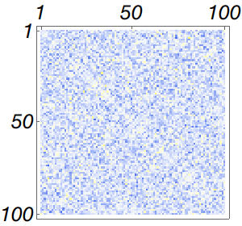
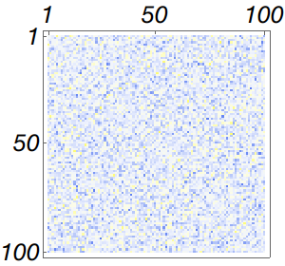
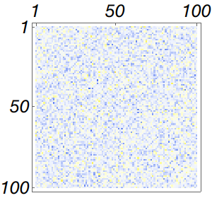
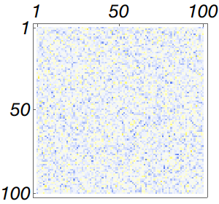
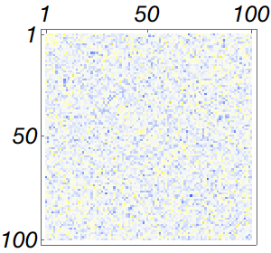
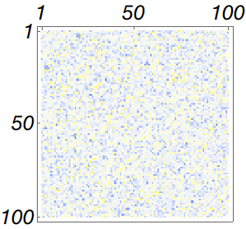
Toy Model: Counting Neurons
Pair-wise correlation among 100 neurons
1-Replica (Plain)
2-Replica
3-Replica
5-Replica
10-Replica
20-Replica
Notes:
Here is a set of simulation of 100 neurons.
This six panels are the correlation matrix plots of different number of replica. From left to right we have one-replica model which is the original network. And 2, 3, 5, 10, 20 replica ones.
We can see that the correlation gradually vanishese when the number of replica increases.

Slide 31
Replica-Mean-Field Limit
$$2λ$$
$$1$$
$$λ$$
$$λ$$
$$3$$
$$2λ$$
unknown mean firing rate
$$2λ$$
$$2$$
$$λ$$
Poissonian Independence Assumption
Notes:
So the result of this replica limit is that all the neurons become independent.
They receive Poissonian inputs at a rate of 2\lambda and generate Poissonian output at a rate of \lambda.
Where \lambda is the unknown mean firing rate of those identical neurons.

Slide 32
Replica-Mean-Field Limit
$$2λ$$
$$1$$
$$λ$$
$$λ$$
$$3$$
$$2λ$$
unknown mean firing rate
$$2λ$$
$$2$$
$$λ$$
Poissonian Independence Assumption
$$μG^{′}\left(z\right)+\left[λ\left(K−1\right)\left(z^{−1}−1\right)+bz^{−1}\right]G\left(z\right)=λz^{−1}$$
$G\left(z\right)=\sum_{k≥0}{P_{k}z^{k}}$ is the probability generating function (PGF)
Notes:
With this assumption, we can then write down an ordinary differential equation of the probability generating function G.
This is just a first order ODE and it is not hard to solve. But notice that in the equation there is the unknown firing rate \lambda.
Which indicates that we will get an infinite family of solutions that depends on \lambda.

Slide 33
Replica-Mean-Field Limit
$$2λ$$
$$1$$
$$λ$$
$$λ$$
$$3$$
$$2λ$$
unknown mean firing rate
$$2λ$$
$$2$$
$$λ$$
Poissonian Independence Assumption
$$μG^{′}\left(z\right)+\left[λ\left(K−1\right)\left(z^{−1}−1\right)+bz^{−1}\right]G\left(z\right)=λz^{−1}$$
$G(z)$ is analytic and $G\left(1\right)=1$
Notes:
But there will only be one feasible solution when we consider the analyticity condition of G.
Then if we further use the normalization condition G(1)=1,

Slide 34
Replica-Mean-Field Limit
$$2λ$$
$$1$$
$$λ$$
$$λ$$
$$3$$
$$2λ$$
$$2λ$$
$$2$$
$$λ$$
Self-consistent equation
$$\frac{e^{−p}p^{α}}{γ(α,p)}=λ$$
$$p=\frac{λ\left(K−1\right)}{μ},α=\frac{λ\left(K−1\right)+b}{μ}$$
with
$γ(α,p)$ is the lower incomplete gamma function
Notes:
We will get the self-consistent equation of the rate \lambda.
This is the core of our approach, which will be used later.

Slide 35
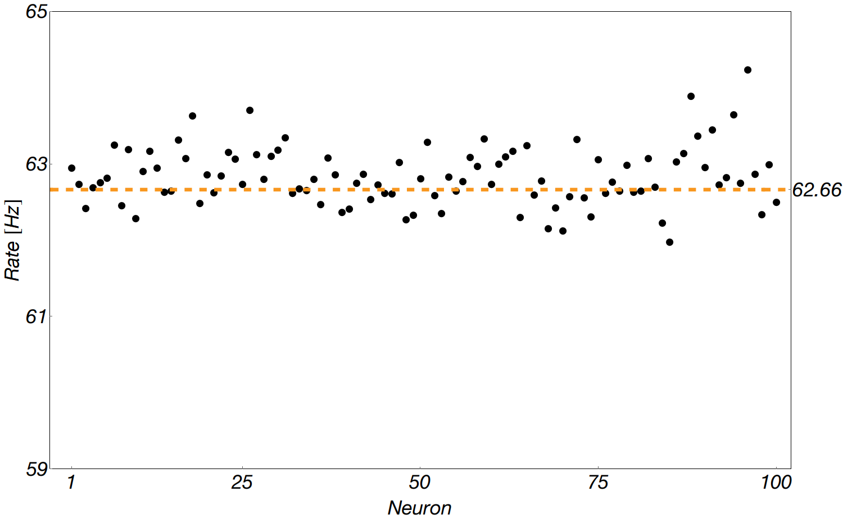
Linear Counting Neurons
100 identical neurons, $b=0.05$, $μ=1.00$
$2×10^{6}$ spike events simulated
Simulation
Replica limit calculation
Notes:
Here is a comparison between the simulation results and our self-consistent equation calculation.
This is a simulation of 100 neurons with this set of parameters where the base rate b=.05 and the connection strength \mu=1.
In this figure, the horizontal axis is the label of neurons and the vertical axis is the firing rates.
The black dots represent the estimated firing rates of each neuron from the simulation and the orange dash line is our self-consistent calculation.
We can see that they agree with each other quite well.

Slide 36
Replica-Mean-Field Limit
a given network model
under replica limit
write the equation of $G(z)$
solve ODE
infinitely many solutions depending on $λ$
analyticity of $G(z)$
one feasible solution
normalization of $G(z)$
self-consistent equation of $λ$
Notes:
In this toy model, I’ve introduced you the replica limit and demonstrated the procedure of our method.
So let’s do a quick review since this is really the essence of our method which will be used repeatedly.
First we are given a specific model of the neuron and network.
Under the replica mean field limit, we can write done the equation for the probability generating function as an ODE.
If we manage to solve it, we will have an infinite family of solutions depending on the firing rate \lambda.
But there will be only one feasible solution if we apply the analyticity condition of G.
Finally we can get a self-consistent equation for \lambda if we consider the normalization of G.

Slide 37
Summary of Counting Neurons Model
Pros
Simple self-consistent equation and it agrees with simulation;
Allows heterogeneity to a certain degree ( $b→b_{i}, μ→μ_{i},$ connectivity, etc. );
Cons
PGF only takes non-negative exponents, inhibition is problematic.
Notes:
Here is a summary of this toy model.
What we get from this model is that we can write down a very simple self-consistent equation and it agrees with simulation.
Also, although I used a homogeneous network as an example, this model can actually accommodate a certain degree of heterogeneity.
For example, we can change the base rates and weights of spikes to each neuron.
Also the network does not have to be fully connected but follows a connectivity matrix.
The bad about this toy model is that it is unfit to describe inhibition while inhibition is a huge deal in brain networks. If you only have excitatory neurons in your brain, apparently you will get too excited.

Slide 38
Summary of Counting Neurons Model
Moderation of neural excitation promotes longevity
Tavernarakis, N. (2019) Nature, 574, 338-340
Two-fold effects of inhibitory neurons on the onset of synchronization in Izhikevich neuronal networks.
Lin, P. X., Wang, C. Y., & Wu, Z. X. (2019). The European Physical Journal B, 92(5), 113.
Inhibitory neuron transplantation into adult visual cortex creates a new critical period that rescues impaired vision.
Davis, M. F., Velez, D. X. F., Guevarra, R. P., Yang, M. C., Habeeb, M., Carathedathu, M. C., & Gandhi, S. P. (2015). Neuron, 86(4), 1055-1066.
How inhibition shapes cortical activity.
Isaacson, J. S., & Scanziani, M. (2011). Neuron, 72(2), 231-243.
Cortical plasticity induced by inhibitory neuron transplantation.
Southwell, D. G., Froemke, R. C., Alvarez-Buylla, A., Stryker, M. P., & Gandhi, S. P. (2010). Science, 327(5969), 1145-1148.
Notes:
Here I cite some papers that state the importance of inhibition.
The first paper is not about inhibition neuron. I put it here since it just came on to Nature yesterday and it has quite interesting results.
Basically it found that a less excited brain network can promote longer lifespan.
So we know inhibition is really important.

Slide 39
Rectified Linear Counting Neurons
$K_{+}$ excitatory and $K_{−}$ inhibitory fully connected neurons,
homogeneous synaptic strength $μ$
Stochastic intensity
$$1$$
$$λ_{i}\left(t\right)=b+μC_{i}\left(t\right)$$
$$3$$
Counting variable $C_{i}\left(t\right)$
receive excitatory spike
spike and reset
$$2$$
$$C_{i}\left(t\right)→C_{i}\left(t\right)+1$$
$$C_{i}\left(t\right)→0$$
receive inhibitory spike
$$C_{i}\left(t\right)→C_{i}\left(t\right)−1$$
Notes:
OK, so how could we modify our model to accommodate inhibition?
A naïve way would be this. Since the excitatory spike increase the counting variable, how about we decrease the counting variable by one when it receives inhibitory spikes?
Which brings down the stochastic intensity so the probability of the neuron firing is lowered.
This looks good but it actually has problems. When the counting variable becomes a very negative number, the stochastic intensity will become negative, which is not allowed. And moreover, our probability generating function can only take non-negative integers.

Slide 40
Rectified Linear Counting Neurons
$K_{+}$ excitatory and $K_{−}$ inhibitory fully connected neurons,
homogeneous synaptic strength $μ$
Stochastic intensity
$$1$$
$$λ_{i}\left(t\right)=b+μC_{i}\left(t\right)$$
$$≥0$$
$$3$$
Counting variable $C_{i}\left(t\right)$
receive excitatory spike
spike and reset
$$2$$
$$C_{i}\left(t\right)→C_{i}\left(t\right)+1$$
$$C_{i}\left(t\right)→0$$
receive inhibitory spike
$$C_{i}\left(t\right)→C_{i}\left(t\right)−1$$
if $C_{i}\left(t\right)≥1$
Notes:
A better way would be this. Whenever the counting variable is positive, we allow the inhibition to lower it.
Thus the counting variable will always be non-negative. Basically we set a boundary on the counting variable.

Slide 41
Rectified Linear Counting Neurons
$$1$$
$$3$$
$$2$$
Equation for PGF
$$μG^{′}\left(z\right)=\left[p−\left(p+q+b\right)z^{−1}+qz^{−2}\right]G\left(z\right)−qG\left(0\right)\left(z^{−2}−z^{−1}\right)+λz^{−1}$$
$$p=\left(K_{+}−1\right)λ_{+}$$
$$q=\left(K_{−}−1\right)λ_{−}$$
Notes:
Now we can do the same thing.
We write down the equation for the probability generating function.
Here p and q are the effective input rate of excitation and inhibition.
We notice there are new terms due to the presence of inhibition, and due to the boundary we set on the counting variables.
This equation is harder to solve.

Slide 42
Rectified Linear Counting Neurons
$$1$$
$$3$$
$$2$$
Two types of singularities
$$G\left(z\right)=g\left(z\right)−qG\left(0\right)I_{−1}\left(z\right)+\left[qG\left(0\right)+λ\right]I_{0}\left(z\right)$$
$$I_{n}\left(z\right)=g\left(z\right)\int_{1}^{z}{\frac{s^{n−1}}{g\left(s\right)}ⅆs}$$
and
$$g\left(z\right)=e^{−p+q}e^{pz−qz^{−1}}z^{−\left(p+q+b\right)}$$
Notes:
By writing down the formal solution there are two types of singularities present and we need to cancel them all to make the solution analytic.

Slide 43
Rectified Linear Counting Neurons
$$1$$
$$3$$
$$2$$
Recurrence relation
$$\left(p+q+b+μn\right)I_{n}\left(z\right)=pI_{n+1}\left(z\right)+qI_{n−1}\left(z\right)+z^{n}−g\left(z\right)$$
Inversion of infinite tridiagonal matrix
can be solved numerically
Notes:
And this somehow leads to solving a recurrence relation that is equivalent to inverting an infinite tridiagonal matrix.
Luckily, the convergence of the inversion is guaranteed due to its special structure.

Slide 44
Rectified Linear Counting Neurons
$$1$$
$$3$$
$$2$$
Self-consistent equation
$$\frac{1}{λ_{+,−}}=\frac{c_{+,−}(λ_{+},λ_{−})}{1−d_{+,−}(λ_{+},λ_{−})}$$
$c_{+}, d_{+},c_{−},d_{−}$ is related to the inversion of an infinite tridiagonal matrix
Notes:
Now we can write out the self-consistent equation, which we’ve come up with an efficient algorithm to solve it.

Slide 45
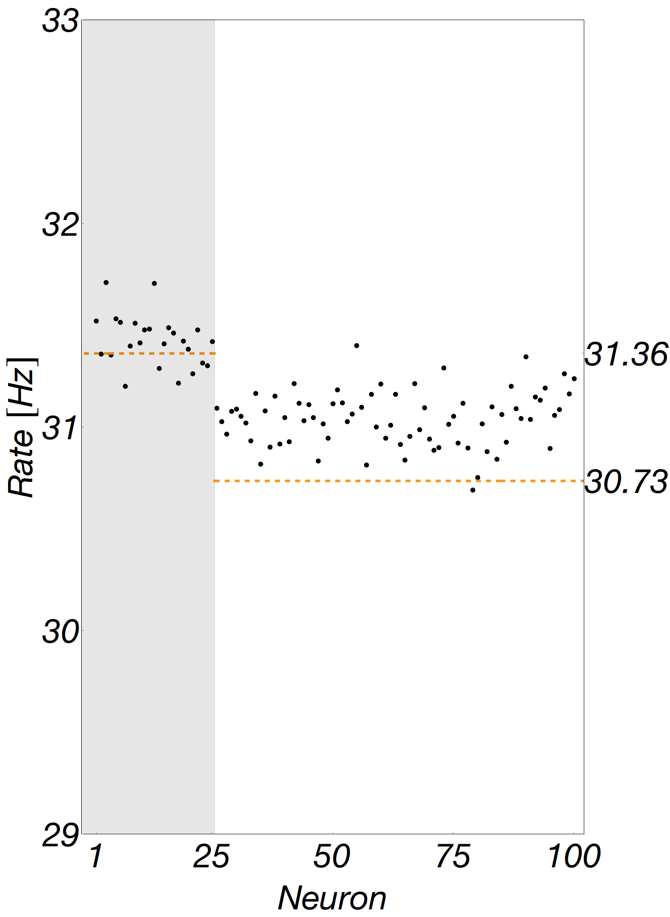
Rectified Linear Counting Neurons
100 neurons, two populations, $b=0.05$, $μ=1.00$
$2×10^{6}$ spike events simulated
Excitation dominated
$$K_{+}≫K_{−}$$
Notes:
Now let’s compare it with the simulations. Again, we simulate 100 neurons with the same parameters. But this time, these 100 neurons contain two populations.
As I plot here, the shaded portion indicates the inhibitory neurons. In this case, we have 25 inhibitory neurons and 75 excitatory neurons. This is called the excitation dominated regime.
We can see that in this regime, the simulations and our calculation agree fairly well. Though the rate of excitatory neurons is a little bit underestimated.

Slide 46
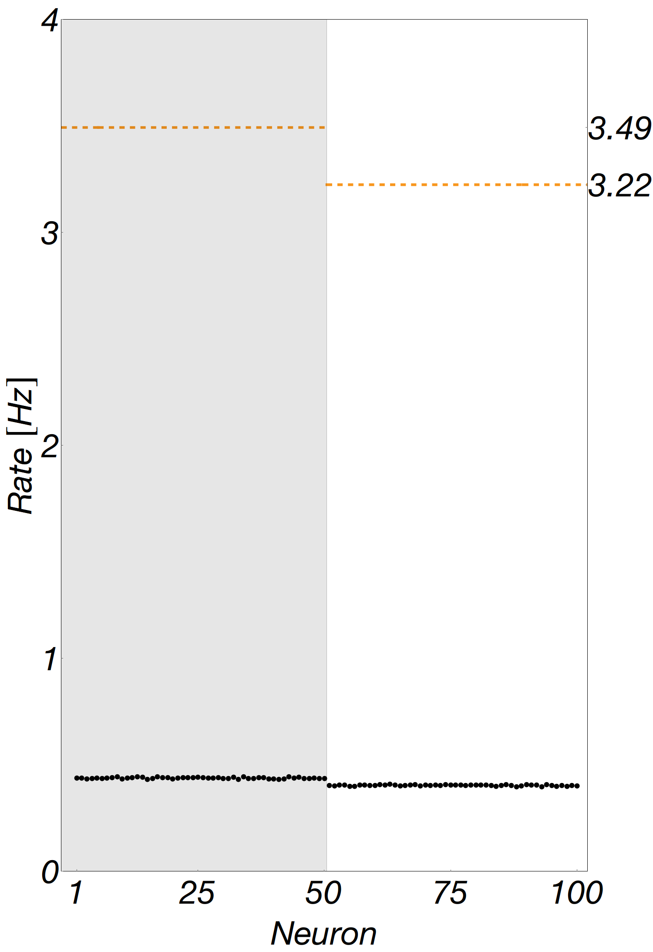
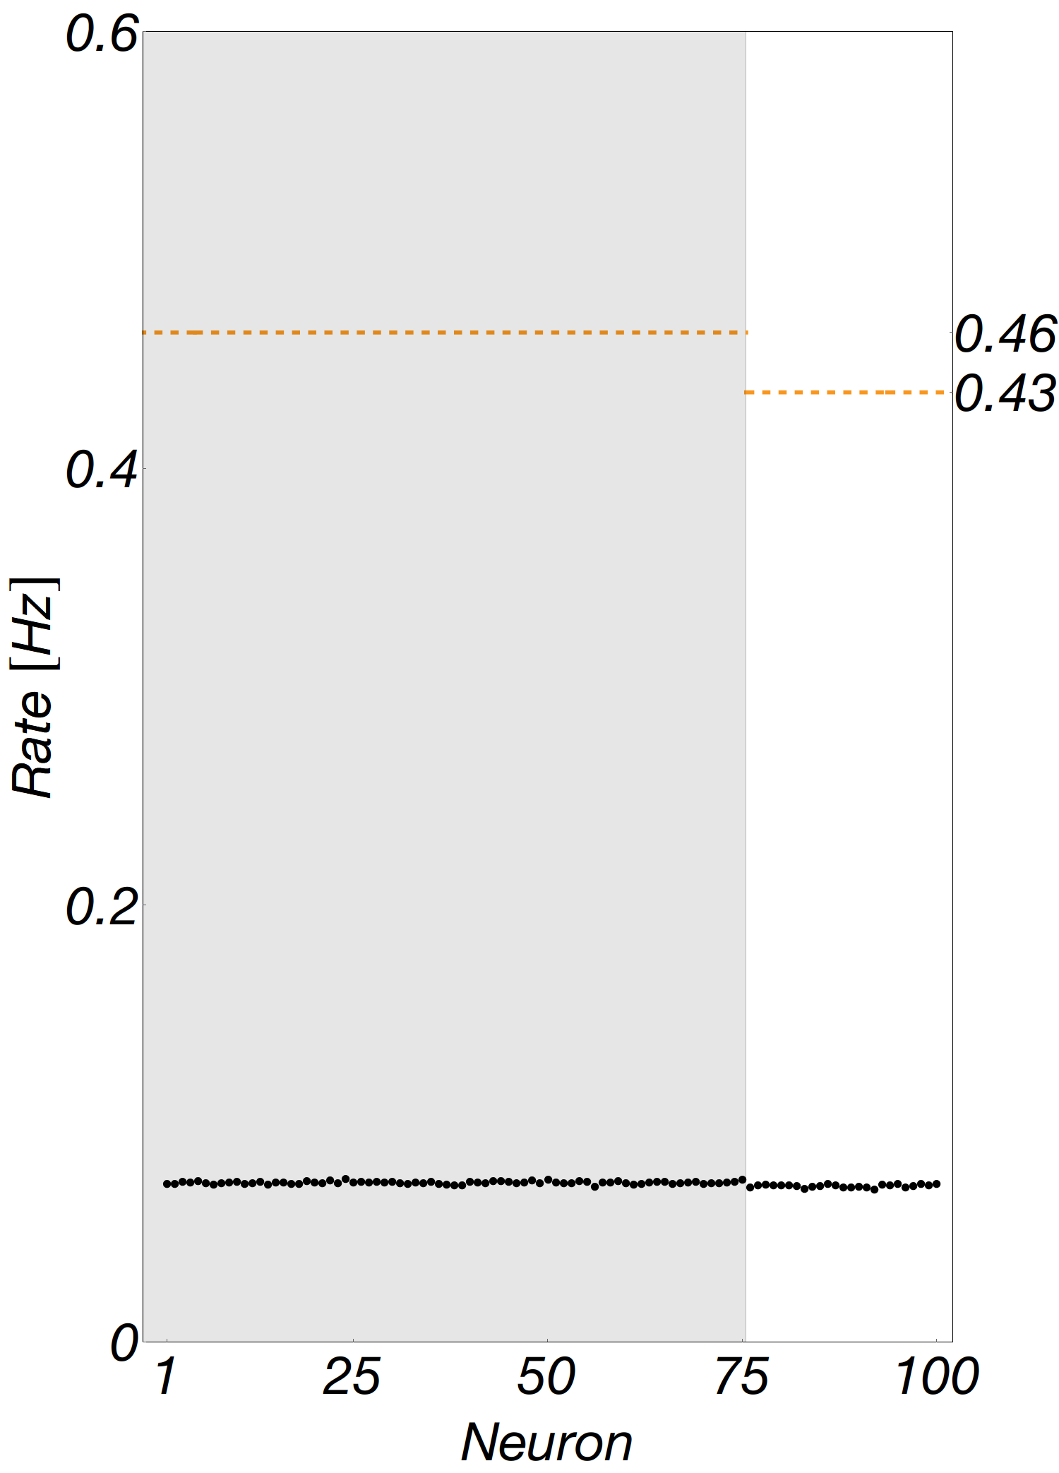
Rectified Linear Counting Neurons
100 neurons, two populations, $b=0.05$, $μ=1.00$
$2×10^{6}$ spike events simulated
Excitation dominated
$$K_{+}≫K_{−}$$
Balance
$$K_{+}≈K_{−}$$
Inhibition dominated
$$K_{+}≪K_{−}$$
Notes:
However, if we look at another two regimes, our calculation does not do a good job.
This is the balance regime where the number of two populations are about the same. And this is the inhibition dominated regime, where we have way more inhibitory neurons.
Well, but at least now we have one regime that this model can work.

Slide 47
Rectified Linear Counting Neurons
$$1$$
$$3$$
$$2$$
Recurrence relation
$$\left(p+q+b+μn\right)I_{n}\left(z\right)=pI_{n+1}\left(z\right)+qI_{n−1}\left(z\right)+z^{n}−g\left(z\right)$$
Notes:
During the process of solving the equation, we actually gained more understandings about the replica limit.
If we go back and look at this recurrence relation, it actually corresponds to a random walk model.

Slide 48
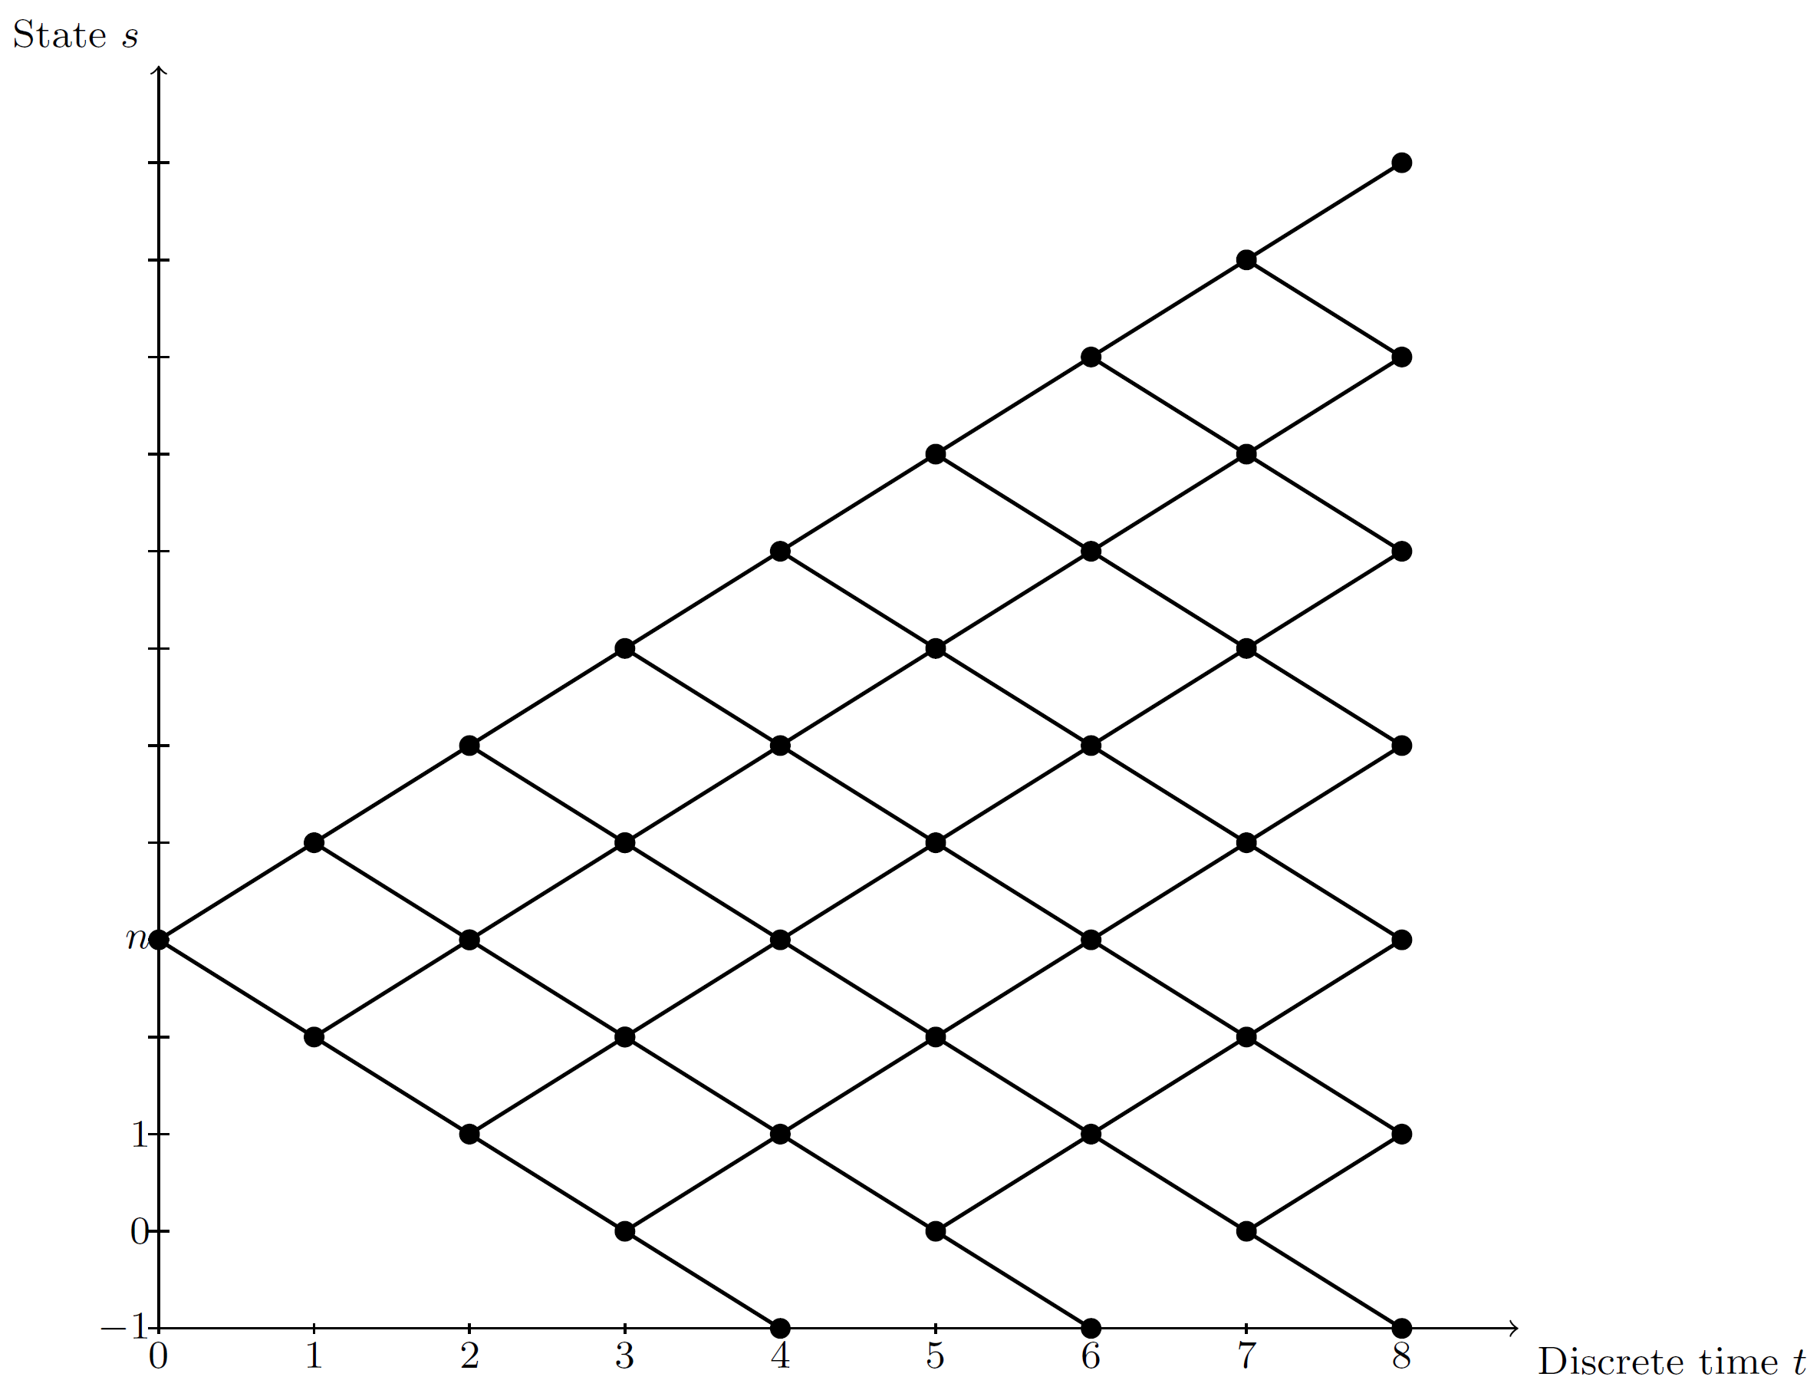
Rectified Linear Counting Neurons
Random walk interpretation
$$I_{n}=\left[1−f\left(n\right)\right]\left(P_{up}I_{n+1}+P_{down}I_{n−1}\right)+f\left(n\right)\frac{z^{n}−g\left(z\right)}{b+μn}, n≥−1$$
$$f\left(n\right)=\frac{b+μn}{p+q+b+μn},P_{up}=\frac{p}{p+q},P_{down}=\frac{q}{p+q}$$
Notes:
At each stage, the neuron can either spike and stop the random walk; or if not, it will go up with the probability proportional to the excitatory input it receives, or go down with the probability proportional to the inhibitory input.
Also, there is an absorbing boundary due to the boundary we set on the counting variable.

Slide 49
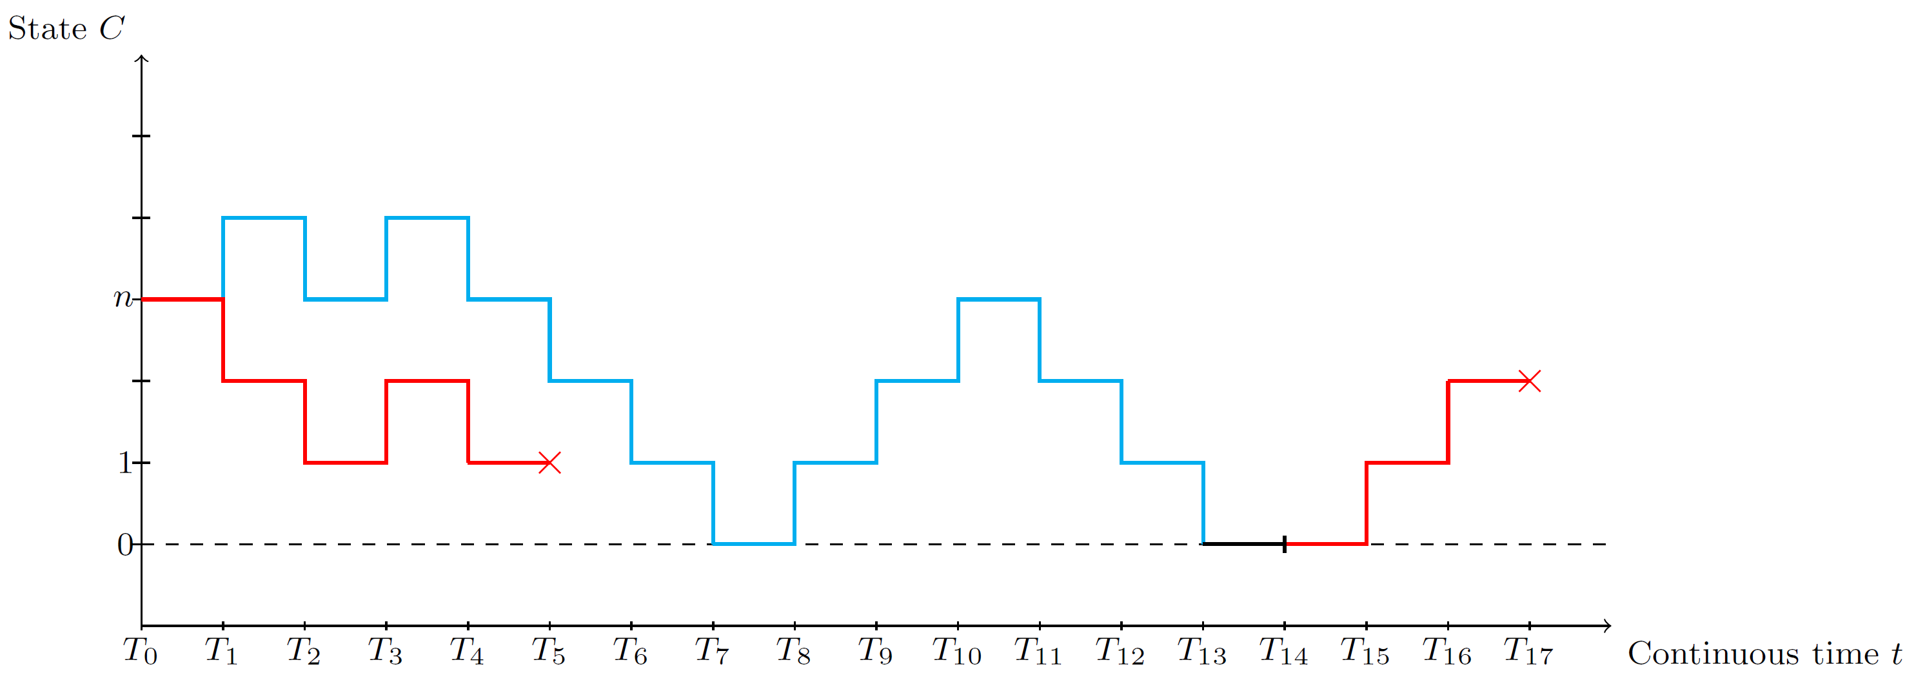
Rectified Linear Counting Neurons
Random walk interpretation
$$\frac{1}{λ_{+,−}}=\frac{c_{+,−}(λ_{+},λ_{−})}{1−d_{+,−}(λ_{+},λ_{−})}$$
$$\frac{𝔼_{τ}\left(red\right)+𝔼_{τ}\left(blue\right)}{ℙ\left(red\right)}=𝔼\left[τ\right]$$
Replica model with PGF approach gets to the equation quicker!
(…but with little intuition)
Notes:
If we start from this random walk picture and do analysis of the path structures, we can actually arrive at the same self-consistent equation.
But this calculations will take 5 pages while the other procedure gives the same equation in less than half page.
Indeed, we lost the probabilistic meaning of the equation but that’s some acceptable sacrifice to make.

Slide 50
Summary of Rectified Linear Counting Neurons
Pros
Fast numerical method exists;
Allows heterogeneity to a certain degree ( $b→b_{i}, μ→μ_{i},$ connectivity, etc. );
Can accommodate inhibition, works well in excitation dominated regime.
Cons
Not good in balance and inhibition dominated regime.
Notes:
Ok, let’s do a quick summary of this new model.
The good things are
First we have fast numerical method to solve this model;
And again, it allows a certain amount of heterogeneity;
Most importantly, it can accommodate inhibition and works well in this excitation dominated regime.
But in the other regime which are actually very important regime especially this balance regime, this model does not work well.
What can we do about that?

Slide 51
Exponential Firing Neurons
$K$ neurons,
signs of $μ$ indicate excitation/inhibition
Stochastic intensity
$$λ_{i}\left(t\right)=be^{ax_{i}\left(t\right)}$$
$$1$$
$$μ_{13}>0$$
Continuous counting variable $x_{i}\left(t\right)$
$$μ_{21}=0$$
$$3$$
receive spike
spike and reset
$$μ_{32}<0$$
$$x_{i}\left(t\right)→x_{i}\left(t\right)+μ_{ji}$$
$$x_{i}\left(t\right)→0$$
$$2$$
Relaxation time $τ$
Notes:
Let’s propose a new model since we don’t want to do patchworks anymore.
Here is the exponential firing neuron model. In this model, we change the stochastic intensity to have an exponential relation with a continuous counting variable x.
This continuous counting variable behaves similarly as our discrete counting variable. When the neuron receives spikes, the connection strength is added to its x.
And here we do not restrict the sign of \mu. We can use positive mu to represent excitatory connection and negative mu as inhibitory synapse, and zero means there is no connection.
When a neuron spikes, its continuous counting variable also reset to zero.
But there is actually a problem here. Since we allow the presence of negative mu, it is possible that the stochastic intensity is suppressed to zero when the counting variable is a huge negative number.
[click]
So we need to introduce a relaxation time here.
What it means is that the counting variable is relaxing when time goes
[click]

Slide 52
Exponential Firing Neurons
$K$ neurons,
signs of $μ$ indicate excitation/inhibition
$$x\left(t\right)$$
Stochastic intensity
$$t$$
$$λ_{i}\left(t\right)=be^{ax_{i}\left(t\right)}$$
$$1$$
$$μ_{13}>0$$
Continuous counting variable $x_{i}\left(t\right)$
$$μ_{21}=0$$
$$3$$
$$x\left(t\right)$$
receive spike
spike and reset
$$μ_{32}<0$$
$$x_{i}\left(t\right)→x_{i}\left(t\right)+μ_{ji}$$
$$x_{i}\left(t\right)→0$$
$$2$$
$$t$$
Relaxation time $τ$
Notes:
As shown in this sketch, before we maintain a perfect memory about the counting variables. But with the introducing of the relaxation time, the counting variable is relaxing towards its base value.

Slide 53
Exponential Firing Neurons
$$1$$
$$μ_{13}>0$$
$$μ_{21}=0$$
$$3$$
$$μ_{32}<0$$
$$2$$
Equation for moment generating function (MGF)
$$−\frac{u}{τ}L_{i}^{′}\left(u\right)+λ_{i}−bL_{i}\left(u+a\right)+\sum_{j≠i}{λ_{j}\left(e^{μ_{ji}u}−1\right)L_{i}\left(u\right)}=0$$
$$L_{i}\left(u\right)=\int_{−∞}^{∞}{e^{ux}p_{i}\left(x\right)ⅆx}$$
Notes:
So, if we do the same thing and write down the equation. We can have this one. Here we cannot use probability generating function anymore but the moment generating function.
The details here are not important, what’s important is that this equation contains both derivatives and a non-local term.
This type of equation is called delay differential equation or more generally, functional differential equation.

Slide 54
Exponential Firing Neurons
$$1$$
$$μ_{13}>0$$
$$μ_{21}=0$$
$$3$$
$$μ_{32}<0$$
$$2$$
Equation for moment generating function (MGF)
$$−\frac{u}{τ}L_{i}^{′}\left(u\right)+λ_{i}−bL_{i}\left(u+a\right)+\sum_{j≠i}{λ_{j}\left(e^{μ_{ji}u}−1\right)L_{i}\left(u\right)}=0$$
Need to solve a delay differential equation (DDE) self-consistently (NEW!)
Notes:
Solving DDE is a fairly new area, its research starts in the 50s and 60s. But all of those is about solving a DDE given an initial function, which is the initial value over a period of time.
But we are gonna solve it based on analyticity. We don’t have an initial function here. This is really a new mathematical problem.
And it would be great if we can solve it. Since DDE is not only used in this context, it is also used in a wide range of areas including physics, biology and finance.
So it highly possible that someone here recognize this problem and could direct us somewhere.
At this stage, by solving it I mean solving it numerically. Since it’s already hard to solve the normal DDE.
During the past 60 years, the cases of DDE found to be analytically solvable are very rare. Most of the researches are done to find numerical method of solving DDE.

Slide 55
Summary
Our findings
Algorithms to calculate spiking rates for the counting model;
More understanding about the replica limit ( random walk picture ).
Next step
Solve the exponential firing model ( DDE );
Explore other possibilities of modeling.
Notes:
This is a summary of my presentation.
So what we have found so far is some algorithms to calculate the neural spiking rates for the two types of counting models.
And during this process, we’ve gained more understanding about the replica limit.
What we are gonna do next is trying hard to solve the exponential firing model which involves the solving of DDE self-consistently.
And we should never stop exploring other possibilities of neuron modeling.

Slide 56
Thank you!
Q & A

Slide 57
Other Extensions: Higher Order Replica Limit
Order-2 replica limit
$$1$$
$$2$$
$$3$$
$$2$$
$$3$$
$$1$$
Keep correlation among up to a certain number of neurons

Slide 58
Replica Mean Field Limit
Spike!
$$1$$
$$3$$
Replica 1
$$2$$
Receive!
Replica 2
Receive!
Replica 3

